Slide 1

Interfacial Dynamics of Surfactant: A Molecular Dynamics Study
CHE4597 Project Defense
Teslim Olayiwola^{1 *}, Toheeb Balogun^{1 *} & Chidera Nnadiekwe^{2*}
¹Department of Chemical Engineering
²Department of Chemistry
*Equal Contributions
Advisor: Dr. Revati Kumar

Slide 2
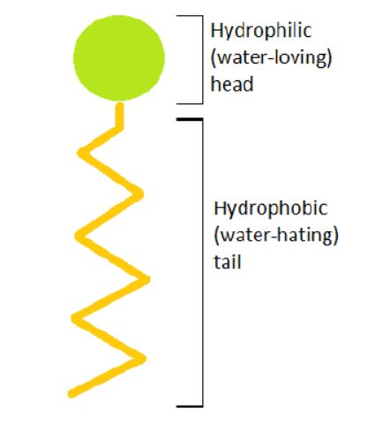
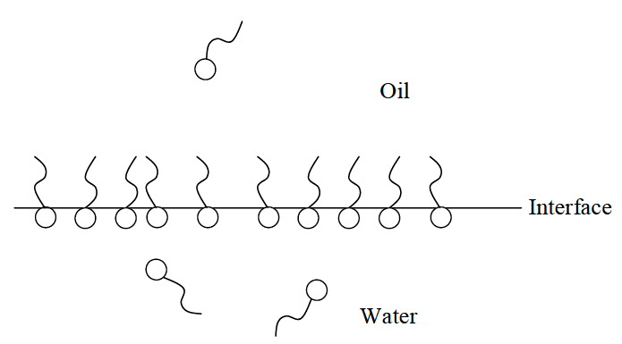
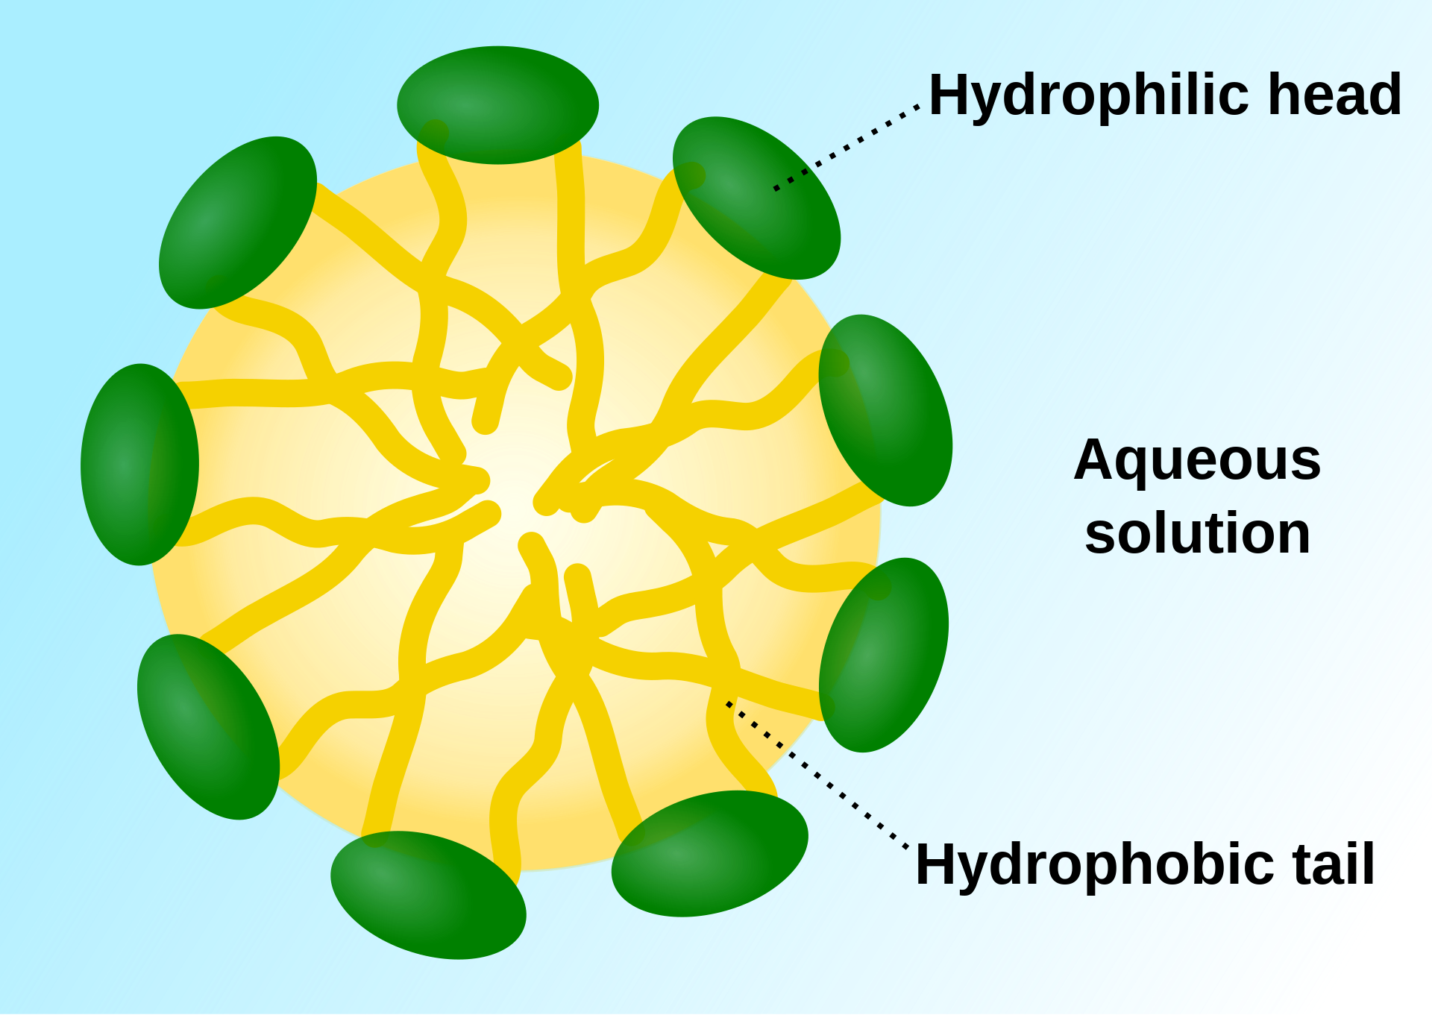
Surfactant
Surfactants: chemical compounds that decrease the surface tension or interfacial tension between two liquids.
Applications as emulsifiers, wetting agents, detergents, foaming agents, or dispersants.
In a pure aqueous solution or oil/water mixture, they behaves such that the hydrophobic tails repels water while the hydrophilic head expose to water.

Slide 3
Motivation & Aim
Understand the

Slide 4
Our approach
MD
Create Topology
Simulation files
Equilibration
Production
NVT
NPT
NVT

Slide 5
Molecular Dynamics – The Mathematics
Here, we will show some of the maths involved in the computation of some of our properties. We plan to compute 1) Interfacial Tension (IFT), 2) density
xxx

Slide 6
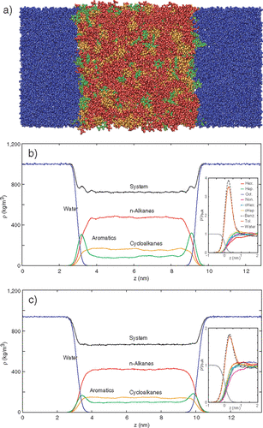
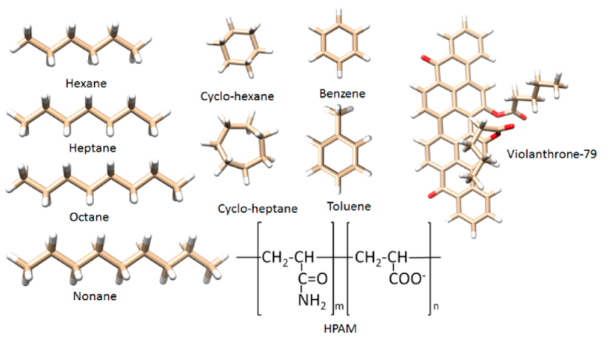
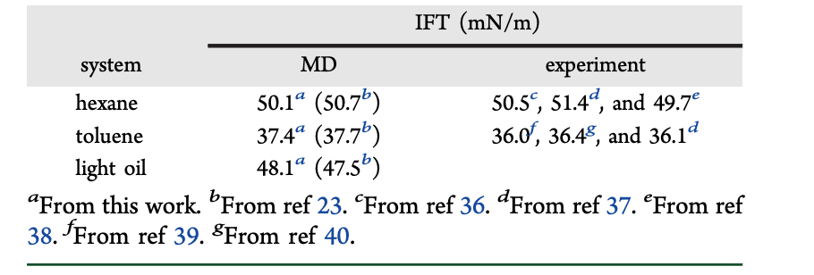
Literatures
Kunieda et al, J. Am. Chem. Soc. 2010, 132, 51, 18281–18286
Abdel-Azeim & Kanj, Energy Fuels 2018, 32, 3, 3335–3343

Slide 7
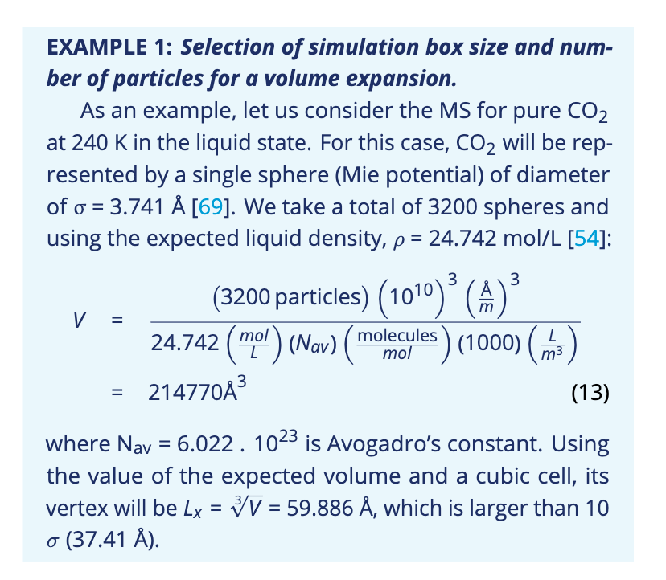
Results & Discussion
Hyundai HDC-6 Neptune truck
Xxx
Xxxx
xxxx
F. Wagner, M. Mathias, J. Phys. Chem. Lett. (2010)
V. Murthi, US DOE HTPEM Workshop, Nikola Motor (2020)

Slide 8
Conclusions
Xxxx
xxxx

Slide 9
Thank You!

